Slide 1
The 10 Federal Home and Community Based Services Regulation from DDS Self Survey
Jeffrey Popkin LCSW ACSW C-ASWCM

Slide 2
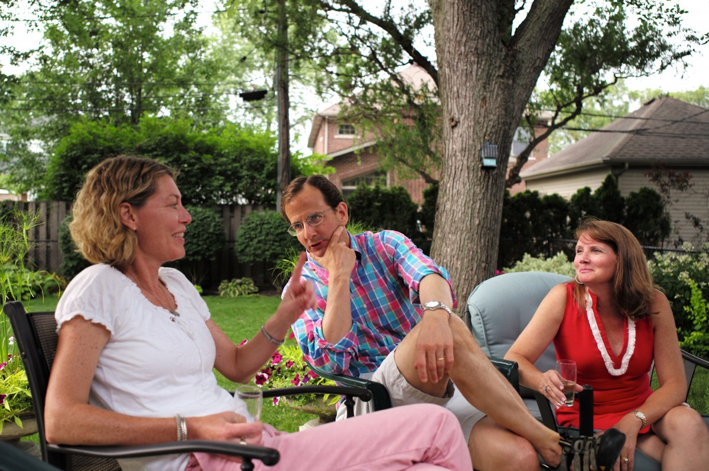
Federal Requirement #1: Access to the Community
The setting/service is integrated in and supports full access to the greater community, including opportunities to seek employment and work in competitive integrated settings, engage in community life, control personal resources, and receive services in the community, to the same degree of access as individuals not receiving regional center services.
As part of their plan for services, do individuals have the opportunity to participate in individual and group outings and activities in the community at the frequency and for the amount of time desired by individuals?
Do the opportunities for community outings and activities include meaningful interaction with individuals not receiving regional center services, not including paid staff or volunteers?

Slide 3
Federal Requirement #1: Access to the Community
If individuals want to seek paid employment, do they have access to competitive integrated employment opportunities?
Do individuals have the choice to receive related personal services in the community (rather than on site) based on their needs, preferences and abilities to the same degree as individuals not receiving regional center services?
Do individuals have access to transportation options, including public transportation, family/friends/and volunteer organizations that promote ease of use and optimize individuals' independence, per their individual program plan?
Do individuals have the option to control their personal resources, if applicable?

Slide 4
Federal Requirement #2: Choice of Setting
The setting/service is selected by the individual from among various options, including non-disability specific options and an option for a private room in a residential setting. The options are identified and documented in the Individual Program Plan and are based on the individual's needs, preferences, and, for residential settings, resources available for room and board.
Does the provider have a current regional center Individual Program Plan (IPP) on file for all individuals?
Does everyone's IPP document the different options that were considered prior to selecting this service and that the current provider selected was based on the individual needs and preferences?

Slide 5
Federal Requirement #3: Right to be Treated Well
The setting/service ensures an individual's rights of privacy, dignity, respect, and freedom from coercion and restraint.
Does the provider inform individuals, in a manner they can understand, of their rights to privacy, dignity, respect, and freedom from coercion and restraint?
Does the provider have policies and procedures that address individuals' rights of privacy, dignity, respect, and freedom from coercion and restraint?
Does the provider conduct communications, both verbal and written, about an individual's personal information in a manner that ensures privacy and confidentiality?
This Photo by Unknown Author is licensed under CC BY

Slide 6
Federal Requirement #3: Right to be Treated Well
Does the provider ensure individuals have privacy while using the bathroom and when assisted with personal care?
Do staff communicate with individuals based on their needs and preferences, including alternative methods of communication where needed (e.g. assistive technology, Braille, large font print, sign language, participants' language, etc.)?
Are individuals allowed to dress or groom in a manner that is appropriate to the setting while honoring individual choice and life-style preferences?
Are all individuals able to visit with others in private?
This Photo by Unknown Author is licensed under CC BY-NC

Slide 7
Federal Requirement #3: Right to be Treated Well
Does the facility ensure staff is knowledgeable about the capabilities, preferences, interests, and needs of the individuals they serve?
Is there a place for individuals to store belongings in a secure manner, e.g., nightstand, lockbox, room, closet?
Are all individuals able to talk on the phone or comparable technology, text, and read mail/email in private?
This Photo by Unknown Author is licensed under CC BY-SA-NC

Slide 8
Does the provider impose restrictions regarding access within the service location, inside or outside, for individuals or visitors?
Does the provider utilize restraints?
Note: "Restraint" means control of the client's behavior or activities through the use of physical or pharmaceutical means other than postural supports. For providers that utilize restraints, acceptable explanations may include identifying policies that require documentation of the use of interventions and/or restraints in the individual program plan, that informed consent prior to the use of restraints has been obtained, or that it is the providers policy to ensure that individual supports and plans to address behavioral needs are specific to the individual and not the same for everyone else in the setting.

Slide 9
Federal Requirement #4: Independence
The setting/service optimizes but does not regiment individual initiative, autonomy and independence in making life choices, including daily activities, physical environment and with whom to interact.
Do individuals have input into and choice among daily activities that are based on the individuals' needs and preferences?
Do individuals have the ability to control their own schedules?
Does the provider structure its support so that individuals are able to interact with people they choose to interact with, both at home and in community settings including non-disabled peers other than paid staff and volunteers?
Does the provider structure their support so that the individual is able to participate in activities that interest them and correspond with their IPP goals?
Can individuals choose to spend time, including dining, alone or in a private area?
Does the provider support individuals' autonomy to make personal decisions such as practicing religion and voting?

Slide 10
Federal Requirement #5: Choice of Services and Supports
The setting/service facilitates individual choice regarding services and supports, and who provides them.
Does the provider support individuals in choosing which staff provide their care, for example gender or language spoken?
Does the provider have a complaint/grievance policy for individuals and inform individuals how to file a Grievance in communication methods outlined in their IPPs?
Do individuals have opportunities to modify their services or schedules and/or voice their concerns in the manner and timing of their choosing and consistent with their communication abilities and preferences?
If individuals are of retirement age are they offered the choice to retire from a day or work program?

Slide 11
Federal Requirement #6: Residential Agreement
The unit or dwelling is a specific physical place that can be owned, rented or occupied under a legally enforceable agreement by the individual receiving services, and the individual has, at a minimum, the same responsibilities and protections from eviction that tenants have under the landlord tenant law of the State, county, city or other designated entity. For settings in
which landlord tenant laws do not apply, the State must ensure that a lease, residency agreement or other form of written agreement will be in place for each participant and that the document provides protections that address eviction processes and appeals comparable to those provided under the jurisdiction's landlord tenant law.
Does each individual have a lease, residency agreement, admission agreement, or other
form of written residency agreement?
Are individuals informed about how to relocate and request new housing?
In the case of any possible eviction or involuntary relocation, are there policies and procedures in place to ensure individuals have and are informed of eviction protections and the appeals process?

Slide 12
Federal Requirement #7: Privacy
Each individual has privacy in his/her sleeping or living unit:
1. Units have entrance doors lockable by the individual, with only appropriate staff having keys to doors as needed.
Individuals sharing units have a choice of roommates in that setting.
Individuals have the freedom to furnish and decorate their sleeping or living units within the lease or other agreement.
Do individuals have a choice regarding roommates or private accommodations? Note: In regard to the question above, not every provider has to provide the option of a private room, but individuals must have a choice of who they share a room with.
Do individuals have the option to change roommates, if desired?
Do individuals have the option of furnishing and decorating their sleeping or living units in a manner that is based on their preferences, or with their own personal items?
Do individuals have the ability to lock their bedroom doors when they choose?
Are policies in place to ensure only necessary and appropriate staff have access to bedrooms and are there protocols to ensure the policies are followed?

Slide 13
Federal Requirement #8: Schedule and Access to Food
Individuals have the freedom and support to control their own schedules and activities, and have access to food at any time.
Do individuals have access to food at any time?
Does the home allow individuals to set their own daily schedules?
Do individuals have full access to common areas in a home such as a kitchen, dining area, laundry, and comfortable seating in shared areas?
Do individuals have access to public transportation, and where no public transportation is available, are other resources available to them by which to access the broader community to the same degree of access as individuals not receiving regional center services?
This Photo by Unknown Author is licensed under CC BY-SA-NC

Slide 14
Federal Requirement #9: Right to Visitors
Can individuals go with visitors outside the home; such as for a meal or shopping, or for a longer visit outside the home, such as for holidays or weekends?

Slide 15
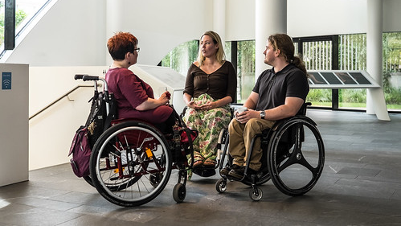
Federal Requirement #10: Accessibility
The setting is physically accessible to the individual.
Do individuals have the freedom to move about inside and outside the home, including bedrooms, bathrooms, and common spaces?
Note: This question also refers to the presence of grab bars, seats in bathrooms, ramps for wheelchairs, etc., if individuals who need those supports are currently being served at the setting.
Are appliances and furniture accessible to every individual?
This Photo by Unknown Author is licensed under CC BY

